Slide 1
C++ Basics III

Slide 2
Homework Review

Slide 3
Switches

Slide 4
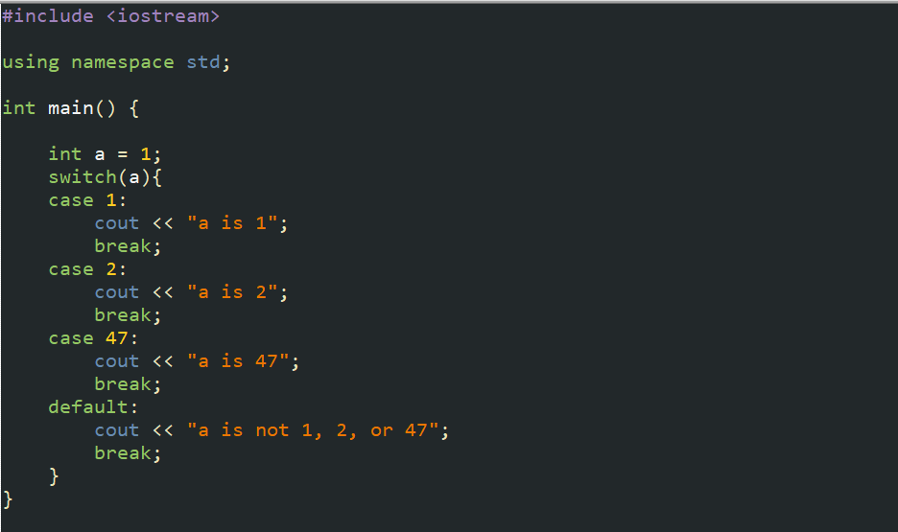
What are switches?
Switches are used to design a specific case for certain variable values. Example:

Slide 5
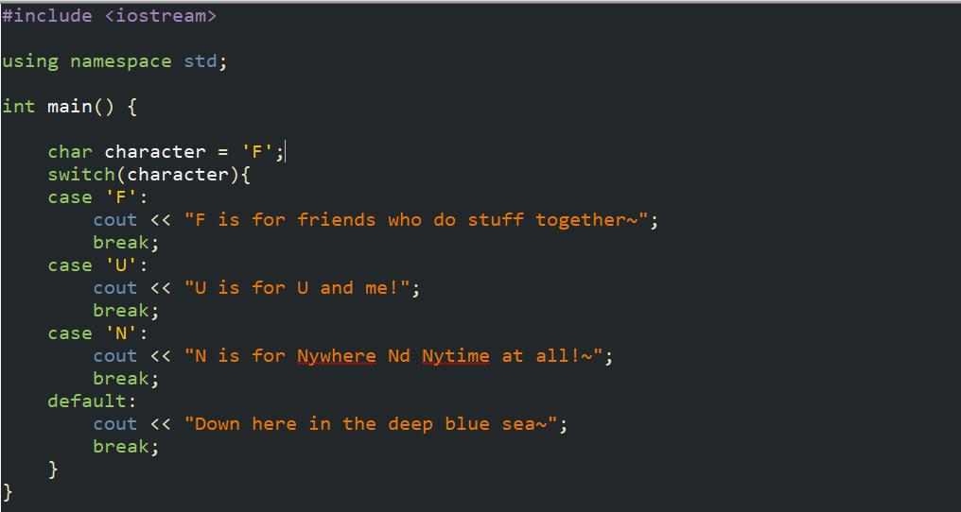
Another example

Slide 6
Functions

Slide 7
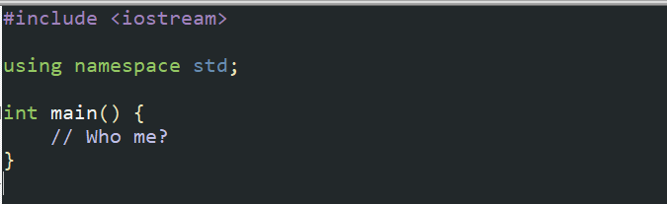
What are functions?
Functions are separate bodies of code that run when called. One function that you have interacted with a lot is the main function!
The main function is better defined as the starting function of your program, and the compiler will always start running code from this function!

Slide 8
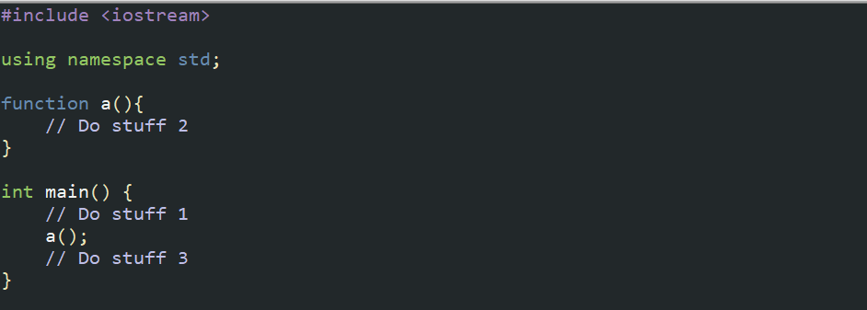
How functions work
To use a function, we must ‘call it’! It works in the following way:
Essentially, every time we call function a, it will do stuff 2 before doing the things in the main function again!

Slide 9
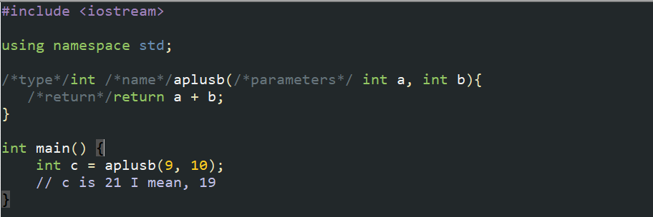
Function declaration
If we want to create and use a function, we need certain elements first! We need a type, name, parameters, and return.

Slide 10
Function types
The function type designates what it should return, below is the following return types for each type:
Type: | What it returns:
void | Nothing
int | An integer
float | A decimal number
char | A character
boolean | A truth value
long long | A bigger whole number
double | A bigger decimal number
string | A ‘string’ of characters
*Every type besides void just returns the correct value for the type*

Slide 11
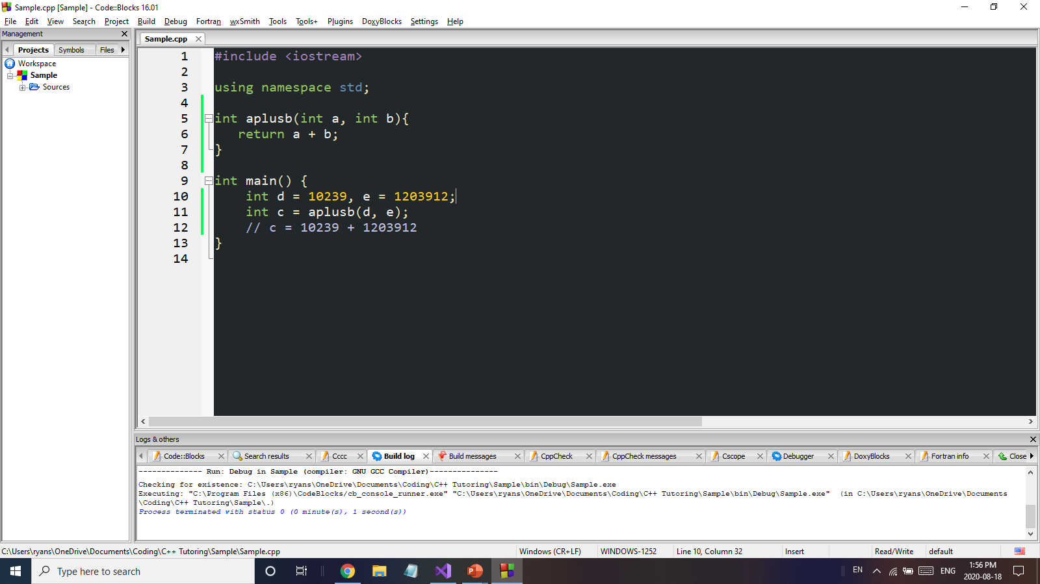
Function Parameters
Parameters are variables we pass into the function, and the function can do things with those variables. When we call the function, we place values or other variables in their place, so that the value we want will carry over into the function:

Slide 12
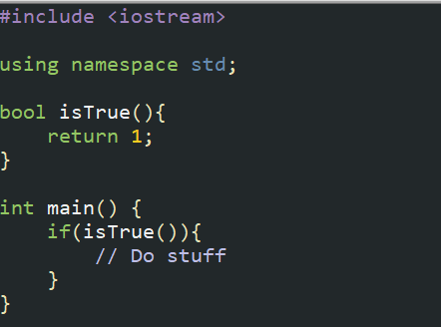
Function Return
After the function runs it’s code, it will return something (if it isn’t a void). This return is similar to a value. In other words, the call of the function is also the value of the function with its given parameters.

Slide 13
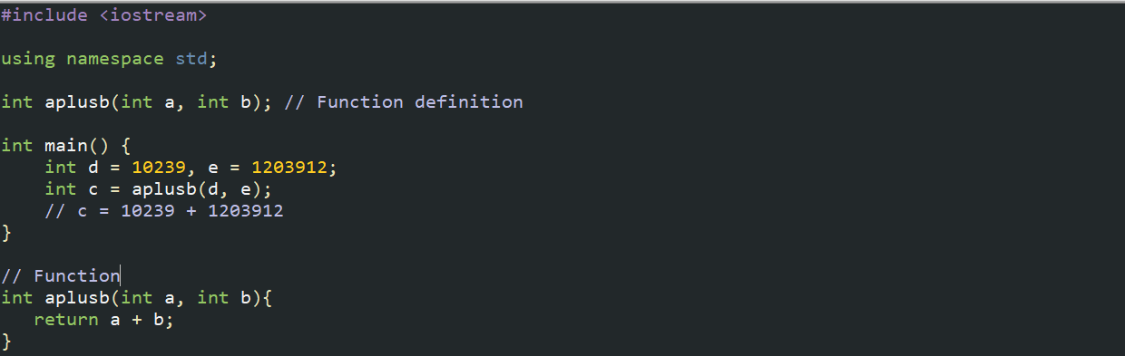
Function declaration
Other than creating the function before the main, there is another way to do it:
This uses a function definition at the top, which is just a reference so that the main function knows that there’s a function there!

Slide 14
Exercise 1
Create a function isPrime, that takes in an integer and tests if it’s prime or not. The function should be a bool.
Use this function to print out the primes from 1-100.

Slide 15
Exercise 2
Create a function isPrime, that takes in an integer and prints out if it is a prime number, a composite number, or 1.
You must use a switch.
The function should be void.

Slide 16
Homework 1
Create a function toBinary that takes in a number, and returns a string representative of the number in binary.
You might want to use <math.h> pow(base, exponent) function.

Slide 17
Homework 2
Create a function isPerfect that takes in a number, and checks if it is a perfect number or not.
A perfect number is one such that the sum of its proper divisors (factors besides 1 and itself) is equal to itself.
Print out all the perfect numbers from 1 - 10000

Slide 18
Homework 3
Create a function isArmstrong that takes in a number, and checks if it is an Armstrong number or not.
An Armstrong number is one such that the sum of the digits raised to the nth power (n is the number of digits) is equal to itself.
Example 153:
153 = 1 + 125 + 27 = 1³ + 5³ + 3³
Print out all of the Armstrong numbers from 1 - 100000

